Slide 1

VECTORS
Dr. Mark Ofori Nketia

Slide 2
Objectives:
In this lecture, students will learn to
add and subtract vectors graphically
express vectors in unit vector notation
relate magnitude and direction of a vector to its components
use the method of components to find sums and differences of vectors
apply these concepts to example problems

Slide 3
Representation of a Vector
A straight line parallel to the direction of the given vector used to represent it. Length of the line on a certain scale specifies the magnitude of the vector. An arrow head is put at one end of the line to indicate the direction of the given vector.
The tail end O is regarded as initial point of vector R and the head P is regarded as the terminal point of the vector R.

Slide 4
Unit Vector
A vector whose magnitude is unity (1) and directed along the direction of a given vector, is calledthe unit vector of the given vector.
A unit vector is usually denoted by a letter with a cap over it. For example if r is the given vector, then r will be the unit vector in the direction of r such that
r = r / r
unit vector = vector / magnitude of the vector

Slide 5
Equal Vectors
Two vectors having same directions, magnitude and unit are called equal vectors.
Equal vectors: If two vectors have equal magnitude and direction, they are equal vectors.
Collinear vectors: Two vectors acting along the same straight lines or along parallel straight lines in the same direction or in the opposite direction are called collinear vectors.
Coplanar vectors: If three or more vectors lie in the same plane, then they are called coplanar vectors.

Slide 6
Zero or Null Vector
A vector having zero magnitude and whose initial and terminal points are same is called a null vector. It is usually denoted by O. The difference of two equal vectors (same vector) is represented by a null vector.
R - R – O

Slide 7
Free Vector
A vector which can be displaced parallel to itself and applied at any point, is known as free vector. It can be specified by giving its magnitude and any two of the angles between the vector and the coordinate axes. In 3-D, it is determined by its three projections on x, y, z-axes.
Position Vector
A vector drawn from the origin to a distinct point in space is called position vector, since it determines the position of a point P relative to a fixed point O (origin). It is usually denoted by r.
If xi, yi, zk be the x, y, z components of the position vector r, then r = xi + yj + zk

Slide 8
Negative of a Vector
The vector A. is called the negative of the vector A, if it has same magnitude but opposite direction as that of A. The angle between a vector and its negative vector is always of 180º.
Multiplication of a Vector by a Number
When a vector is multiplied by a positive number the magnitude of the vector is multiplied by that number. However, direction of the vector remain same. When a vector is multiplied by a negative number, the magnitude of the vector is multiplied by that number. However, direction of a vector becomes opposite. If a vector is multiplied by zero, the result will be a null vector. The multiplication of a vector A by two number (m, n) is governed by the following rules.

Slide 9
1. m A = A m
2. m (n A) = (mn) A
3. (m + n) A = mA + nA
4. m(A + B) = mA + mB

Slide 10
Division of a Vector by a Number (Non-Zero)
If a vector A is divided by a number n, then it means it is multiplied by the reciprocal of that number i.e. 1/n. The new vector which is obtained by this division has a magnitude 1/n times of A. The direction will be same if n is positive and the direction will be opposite if n is negative.
Resolution of a Vector into Rectangular Components
Definition
Splitting up a single vector into its rectangular components is called the Resolution of a vector.

Slide 11
Rectangular Components
Components of a vector making an angle of 90º with each other are called rectangular
components.
Procedure
Let us consider a vector F represented by OA, making an angle O with the horizontal direction.
Draw perpendicular AB and AC from point on X and Y axes respectively. Vectors OB and OC represented by Fx and Fy are known as the rectangular components of F. From head to tail rule of vector addition.
OA = OB + BA
F = Fx + Fy
To find the magnitude of Fx and Fy, consider the right angled triangle OBA.
Fx / F = Cos θ => Fx = F cos θ
Fy / F = sin θ => Fy = F sin θ

Slide 12
Example 1:
A rope is tied to a nail on vertical wall such that the rope make an angle of 60° to the vertical . If 12 N force is applied at the end of the rope, calculate : (I) the force that will bend the nail ( ii ) the force that will pull out the nail from the wall.

Slide 13
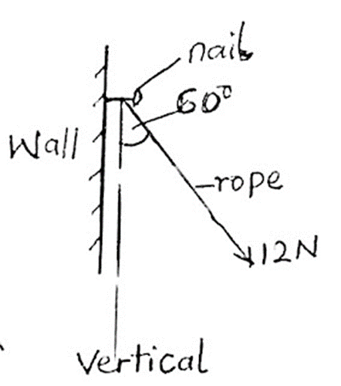
Solution:

Slide 14
Force F on the rope = 12 N, angle of rope to the vertical = 60° The force that will remove the nail is the horizontal component of the Force F. So we are to calculate Fx. Formula: Fx = F * Sin θ Substitution: Fx = 12 * Sin 60° Fx = 12 * 0.8660. ➡ x = 10.39N The force that will remove the nail is 10.39 Newtons. The force that bend the nail is the vertical component of the force F. So we have to calculate Fy : Formula: Fy = F * Cos θ Substitution: Fy = 12 * Cos 60° . Fy * 12 * 0.5 ➡ Fy = 6.0 Newtons The force that will bend the nail is 6.0 Newtons

Slide 15
Example 2
A cord is tied to a nail on the ceiling of a at an angle of 30° to the horizontal. If F Newton force applied on the cord produced a vertical force of 8.0 N, calculate the force the was applied on the cord and the force that will bend the nail

Slide 16
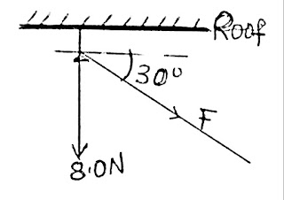
Solution

Slide 17
Data given in the question: Angle θ = 30°, force F = ?, vertical component Fy = 8.0 N, horizontal component Fx= ? Force F that was applied: Formula. Fy = F * Sin 30° Substitution: 8.0 = F * Sin 30° 8.0 = F * 0.5 Make F the subject of formula: F = 8.0 / 0.5. ➡ F = 16.0 Newtons. The force that was applied is 16.0 Newtons.

Slide 18
The force that will bend the nail: The force that will bend the nail is Fx which act in the horizontal direction. Formula: Fx = F * Cos θ Substitution: Fx = 16 * Cos 30° Fx = 16 * 0.8660.➡ Fx = 13.86 newtons. The force that will bend the nail is 13.86 Newtons.

Slide 19
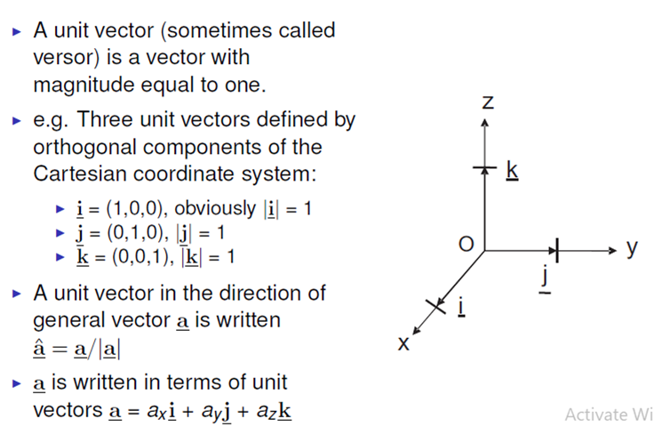
Vector in 3 Dimension

Slide 20
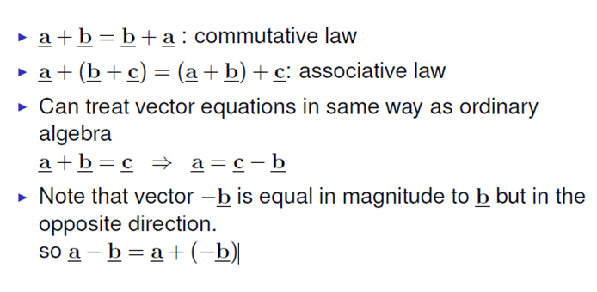
Vector algebra laws

Slide 21
Dot Product:
There are actually several vector products that can be defined. First, we will look at the dot product of two vectors, which is often called their inner product. We multiply corresponding terms and add the result. The result is not a vector, but is in fact a scalar. Defined algebraically, the dot product of two vectors is given by
a= ax + ay
b=bx + by
Therefore a.b=axbx +ayby

Slide 22
Multiplication of Vectors
There are two types of vector multiplication. One produces a scalar quantity and is called the “Dot” or “Scalar” product. The second type produces a vector and is called the “Cross” or “Vector” product.

Slide 23
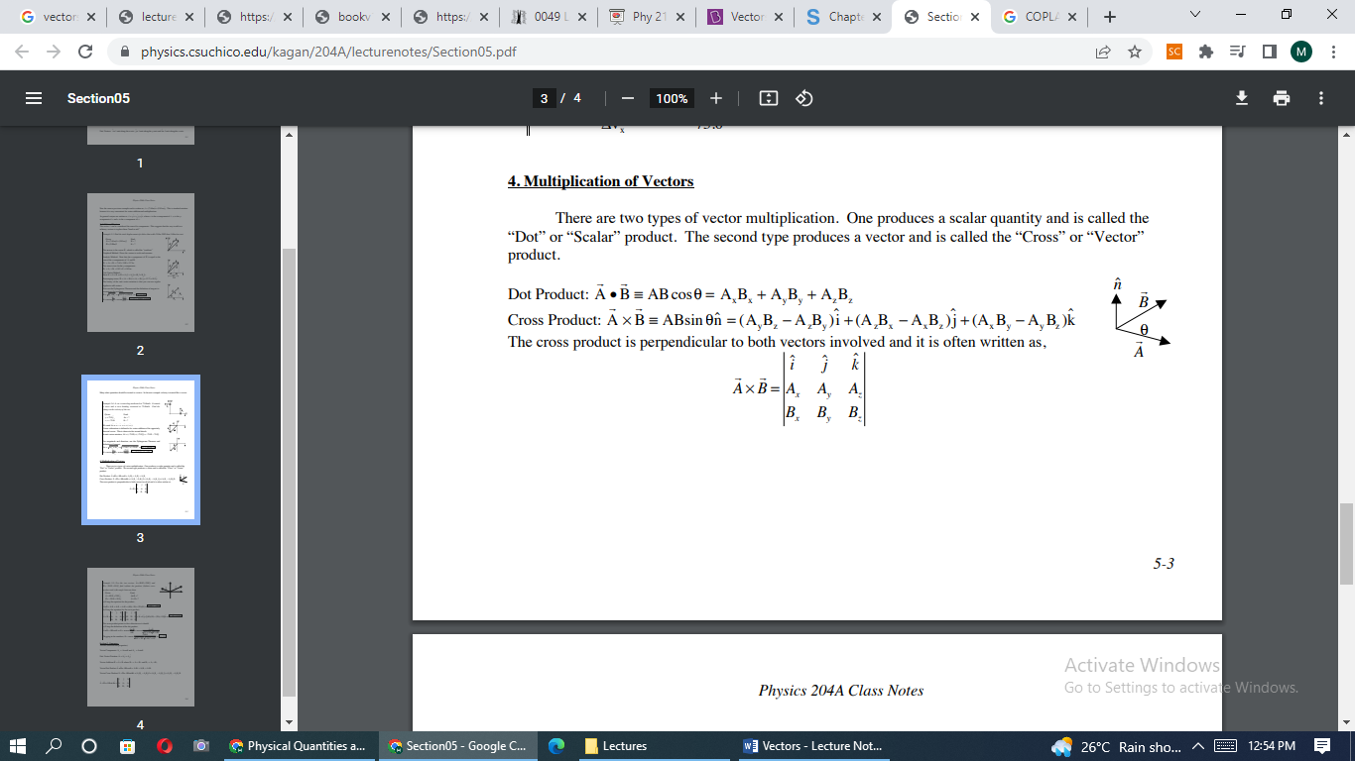

Slide 24
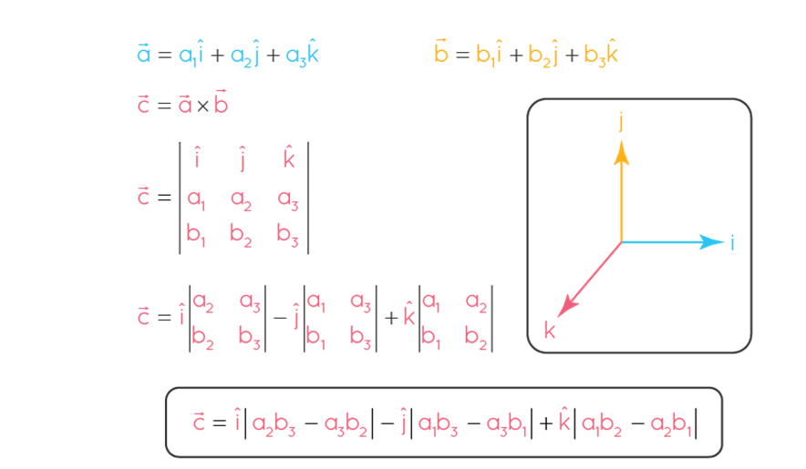

Slide 25
NOTE:
Anytime A and B are parallel, the cross product is zero and the dot product is maximum
If A and B are perpendicular, the dot product is zero and the cross product is maximum.
If one f the vectors is the zero vector, both will be zero

Slide 26
Question 1:
A ball is thrown with an initial velocity of 70 feet per second., at an angle of 35° with the horizontal. Find the vertical and horizontal components of the velocity.

Slide 27
Let v represent the velocity and use the given information to write v in unit vector form:
v =70(cos(35°))i+70(sin(35°))j
Simplify the scalars, we get:
v ≈57.34i+40.15j

Slide 28
Since the scalars are the horizontal and vertical components of v ,
Therefore, the horizontal component is 57.34 feet per second
and the vertical component is 40.15 feet per second.

Slide 29
Multiplying Vectors
There are two ways to “multiply” two vectors together.
The scalar product (or dot product) of the vectors a and b is given by
a · b = ab cos φ
where a is the magnitude of a,
b is the magnitude of b
and φ is the angle between a and b.

Slide 30
The scalar product is commutative: a · b = b · a. One can show that a · b is related to
the components of a and b by:
a · b = axbx + ayby + azbz
If two vectors are perpendicular then their scalar product is zero.
The vector product (or cross product) of vectors a and b is a vector c whose magnitude is given by
c = ab sin φ

Slide 31
NOTE: The dot product is used to find the angle between two vectors because it directly relates to the cosine of the angle between them, which is useful for calculating the angle. The cross product, on the other hand, is used to find a vector that is perpendicular to the plane formed by the two vectors, and its magnitude is related to the sine of the angle between them.

Slide 32
Question 2
Find the angle between
A = −5i − 3j + 2k and
B = −2j − 2k

Slide 33
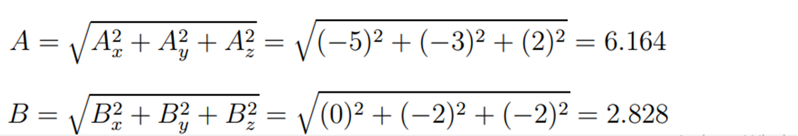
Answer 2:
The magnitudes of the vectors A and B are:

Slide 34
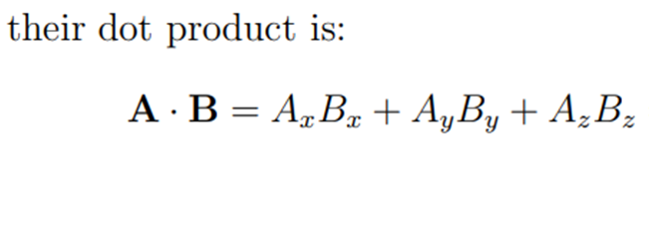


Slide 35
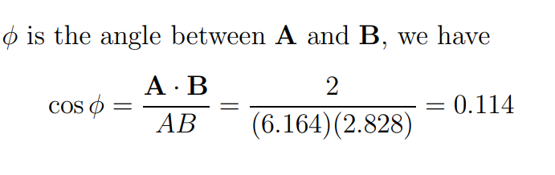
Answer 2:
The scalar product (or dot product) of the vectors a and b is given by
a · b = ab cos φ
Cos Ø = Cos ⁻¹(0.114) = 83.4 degrees

Slide 36
Question 3
Vector A extends from the origin to a point having polar coordinates (7, 70◦ ) and vector B extends from the origin to a point having polar coordinates (4, 130◦ ). Find A · B

Slide 37
Solution 3:
To find A · B. We have the magnitudes of the two vectors (namely A = 7 and B = 4)
And the angle φ between the two is
φ = 130◦ − 70◦ = 60◦

Slide 38
Therefore>
A · B = AB cos φ
= (7)(4) cos 60◦
= 14

Slide 39
Question 4:
Two vectors a and b have the components, in arbitrary units, ax = 3.2, ay = 1.6, bx = 0.50, by = 4.5.
(a) Find the angle between the directions of a and b.
(b) Find the components of a vector c that is perpendicular to a, is in the xy plane and has a magnitude of 5.0 units.

Slide 40
Solution 4:
The scalar product has something to do with the angle between two vectors... if the angle between a and b is φ
So we have: cos φ = a · b
ab
Since we know the components of a and b. First, find a · b

Slide 41
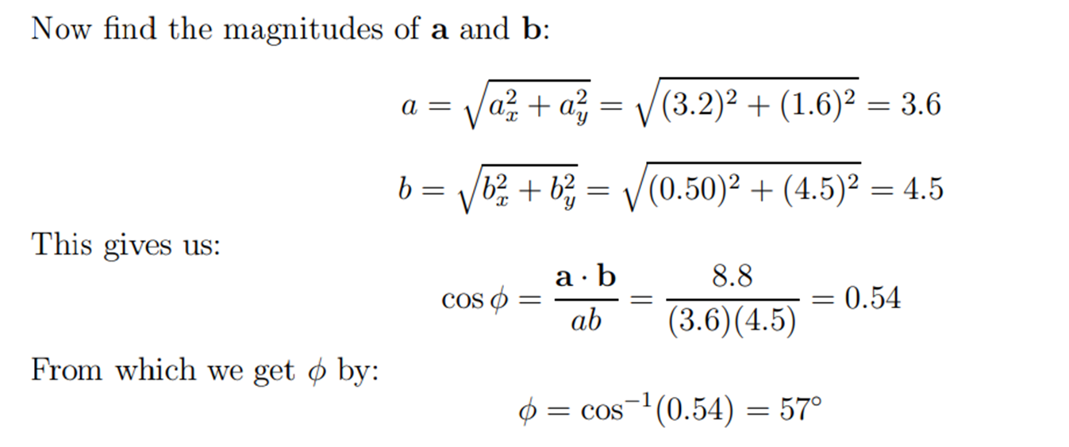
a · b = axbx + ayby
= (3.2)(0.50) + (1.6)(4.5)
= 8.8

Slide 43
(b) Let the components of the vector c be cx and cy (we are told that it lies in the xy plane). If c is perpendicular to a then the dot product of the two vectors must give zero.
This gives us:
a · c = axcx + aycy = (3.2)cx + (1.6)cy = 0
Therefore, (3.2)cx + (1.6)cy = 0

Slide 44
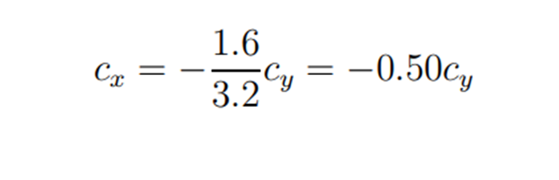
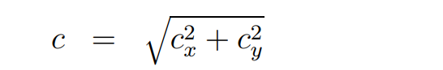
Now lets make Cx the subject:
Using the previous equation to substitute for cx gives:
Since the vector c has magnitude 5.0

Slide 45
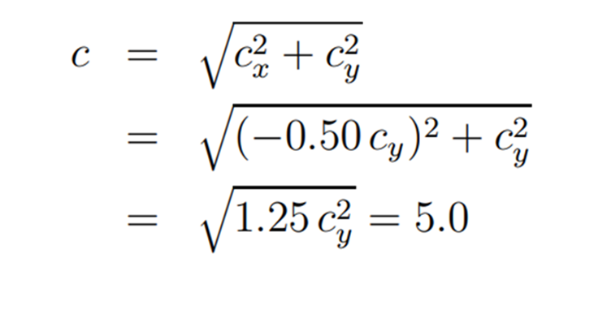

Slide 46


Slide 47
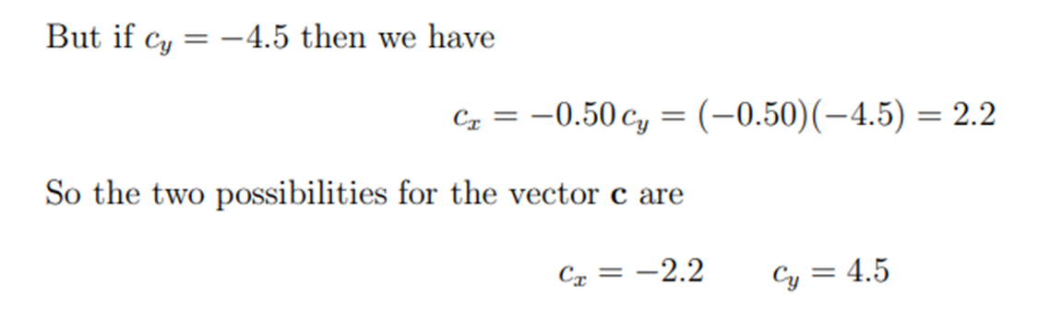
cx = 2.2 cy = −4.5

Slide 48
Question
Calculate the cross products of vectors a = <3, 4, 7> and b = <4, 9, 2>.

Slide 50
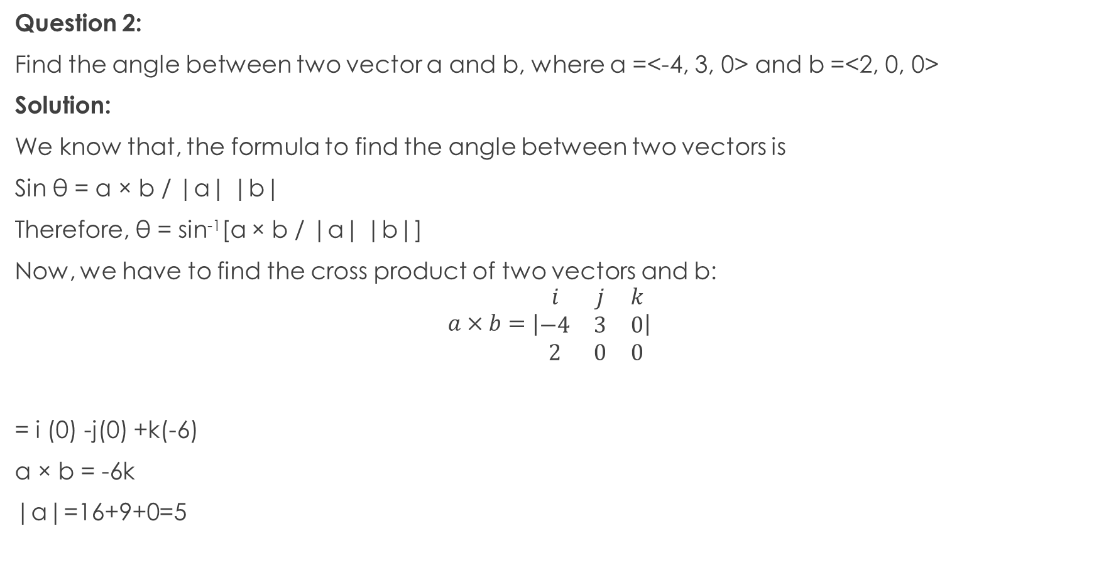
Question 2:
Find the angle between two vector a and b, where a =<-4, 3, 0> and b =<2, 0, 0>
Solution:
We know that, the formula to find the angle between two vectors is
Sin θ = a × b / |a| |b|
Therefore, θ = sin⁻¹[a × b / |a| |b|]
Now, we have to find the cross product of two vectors and b:
$$\begin{aligned}a×b=|\begin{matrix}i & j & k \\ −4 & 3 & 0 \\ 2 & 0 & 0\end{matrix}|\end{aligned}$$
= i (0) -j(0) +k(-6)
a × b = -6k
|a|=16+9+0=5

Slide 51
|b|=4+0+0=2
While finding the angle between two vectors, substitute the magnitude of the vector value, Thus,
|a × b| = 6
Therefore, θ = sin⁻¹[|a × b|/ |a| |b|]
θ = sin⁻¹[ 6/ 5 .2 ]
θ = sin⁻¹[ 3/ 5 ] = 36.87°
Hence, the angle between two vectors, a and b (θ) is 36.87°

Slide 52
Question
If →aa→ = (2, -4, 4) and →bb→ = (4, 0,3), find the angle between them.
Solution
→a→ = 2i - 4j + 4k
→b→ = 4i + 0j +3k
The magnitude of →a→ is
∣a∣=√(2²+4²+4²) = √36 = 6
The magnitude of →b→ is
∣b∣=√(4²+0²+3² ) = √25 = 5

Slide 53
As per the cross product formula, we have
→a×→b= =[(−4×3)−(4×0)]^i−[(3×2)−(4×4)]^j+[(2×0)−(−4×4)]^k =−12^i+10^j+16^k→a×→b =(−12,10,16)a→×b→
=i^j^k^2−44403
=[(−4×3)−(4×0)]i^−[(3×2)−(4×4)]j^+[(2×0)−(−4×4)]k^
=−12i^+10j^+16k^a→×b→
=(−12,10,16)

Slide 54
The length of the →cc→ is
∣c∣=√(−(12)²+10²+16²)
=√(144+100+256)
=√500
=10√5
→a×→b=∣a∣∣b∣sinθsinθ =→a×→b∣a∣∣b∣a→×b→
=∣a∣∣b∣sinθ
sinθ=a→×b→∣a∣∣b∣
sinθ = 10√5/(5×6)
sinθ = √5/3
θ = sin⁻¹(√5/3)
θ = sin⁻¹(0.74)
θ = 48∘

Slide 55
Key notes:
Points to remember
(1) The sum of three non-coplanar forces cannot be zero.
(2) The minimum number of equal forces required for a zero resultant is two.
(3) The minimum number of unequal forces required for a zero resultant is three.
(4) Multiplication of velocity vector by time gives the displacement.
(5) The unit of a vector is not changed if it is multiplied by a dimensionless scalar.

Slide 56
Thank you

